Slide 1



Mobile Charging Using Solar Energy
Vishwakarma Institute of Information Technology, Pune
Project by-
Siddhant Udgirkar 21910623
Vishal Reghate 21910702

Slide 2


COMPONENTS REQUIRED
Solar panel (6V, 3W) – 1 500/-rs
Micro USB cable -1 100/-rs
LM317 Voltage Regulator - 1 20/-rs
BC547 NPN Transistor -1 10/-rs
Small Breadboard 50/-rs
1N5819 Diodes - 2 15/-rs
Resistors 100 Ohms and 150 Ohms - 2
10/-rs
5.6V 1N4734A Zener Diode - 1 10/-rs
Total approximate costing- 750/-rs

Slide 3
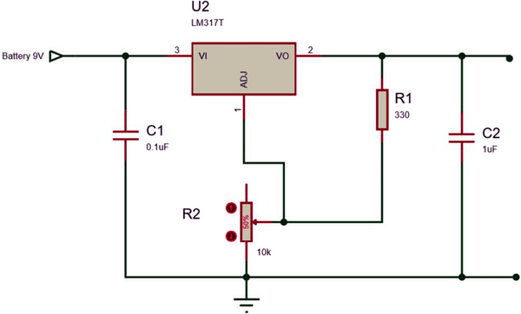
LM317 VOLTAGE REGULATOR
LM317 is a variable voltage regulator. By using LM317, we can vary the voltage up to 37V with a max current of 1.5A. To get the variable output voltage, the below circuit is used.
The output voltage can be calculated by using the below formula:
V_{out} = 1.25(1 + (R₂/R₁))
Now, by varying the value of the resistor R_{2,} you can vary the output voltage.
Note: Even though the output voltage is dependent on the external resistors connected to the LM317, the input voltage should be greater (minimum of 3V) than the desired output voltage.

Slide 4
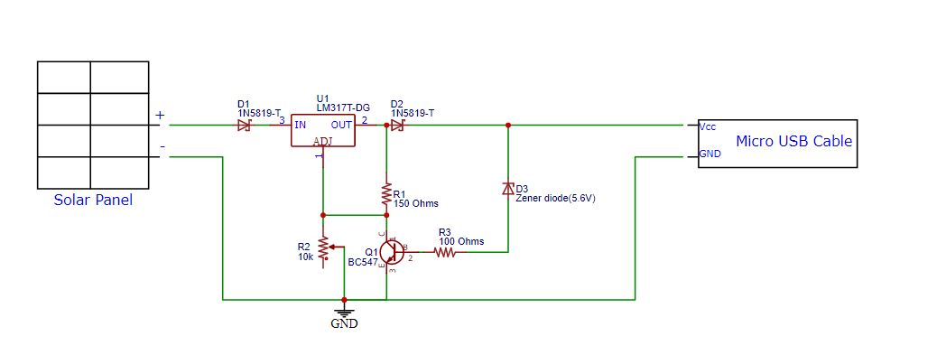
SOLAR MOBILE PHONE CHARGER CIRCUIT DIAGRAM

Slide 5
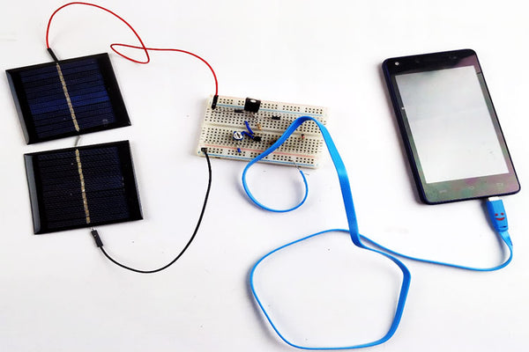
Assembly

Slide 6
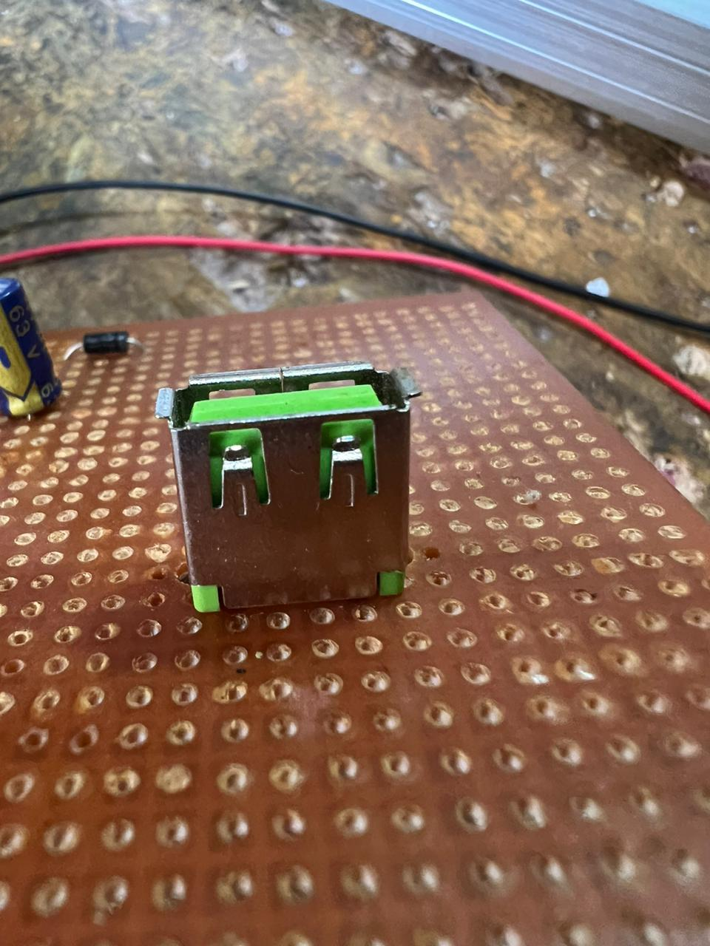
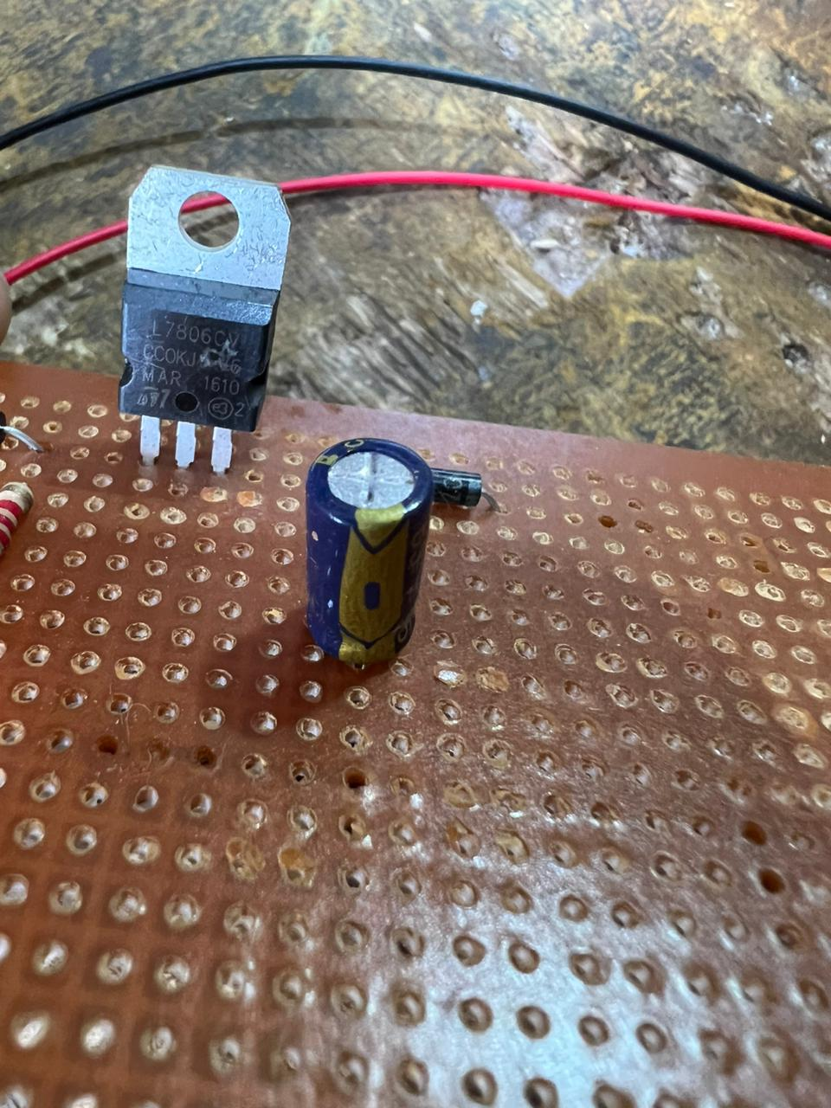
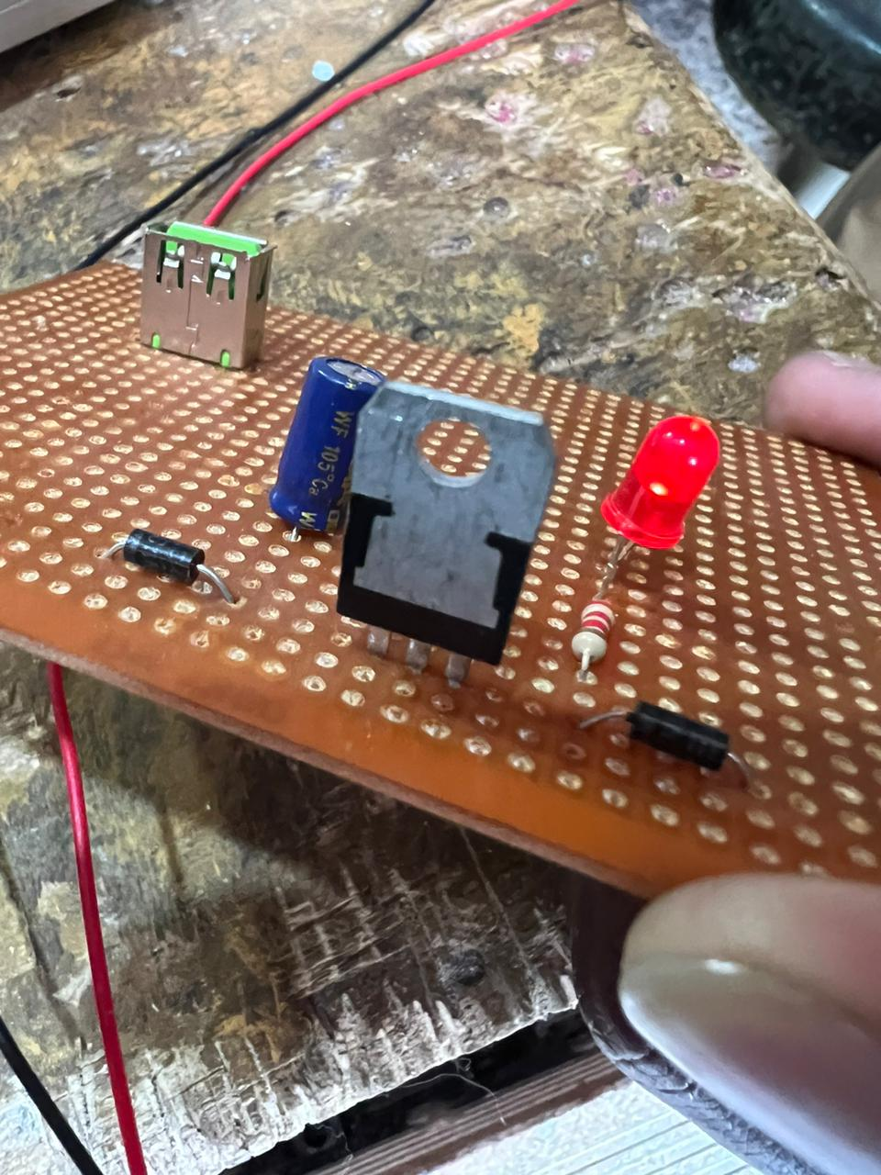
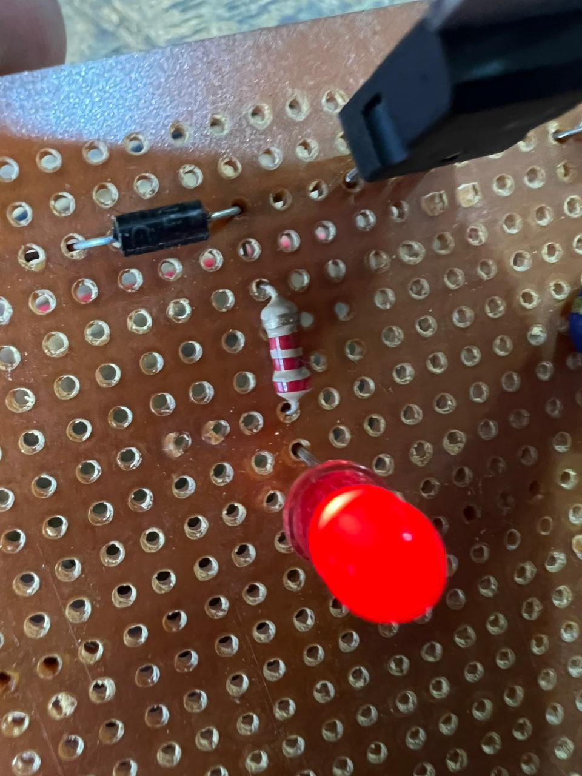
Trials

Slide 7
Working
Solar cells are usually made out of silicon wafers. The silicon atoms in the solar cells form 4 strong bonds with its neighboring silicon atoms. By having these strong bonds, the electrons will stay in one place, and no current flow is seen. These solar cells usually have two layers of semiconductors. The top layer of the solar cell is doped with phosphorous to convert it into an n-type semiconductor, and the lower layer is doped with boron to convert it into a p-type semiconductor. The N-type layer has excess electrons, and the p-type layer has extra holes. When light particles strike the solar cell, the photons present in the light will have enough energy to knock the electrons from their bond, leading it to move towards the N-side, and the hole (formed by the absence of an electron) will move towards the P-side. The movable electrons are then collected at the thin metal material present at the top of the solar cell.

Slide 8
If an external circuit is connected to these metal materials, the electrons will flow into the external circuit and then reach the conductive aluminum sheet present at the back of the solar cell. The electron then settles in the hole which is present in the P-type layer of the solar cell. Each solar cell has a voltage of 0.5V to 0.6V. The solar cells are connected in series to get the required voltage. Usually, 12 solar cells connected in series are sufficient to charge a mobile phone. There are three types of solar panels. They are Monocrystalline, polycrystalline, and thin-film. In our project, we are going to use two 6V 80mA solar panels. We are connecting the two solar panels in series to get a voltage of 12V and 80mA. The below pic shows the single mini solar panel which can generate an output voltage of 6V with a max current of 80mA.

Slide 9
Thank You

